Slide 1
Single-Area OSPF Implementation
Troubleshooting OSPF

Slide 2
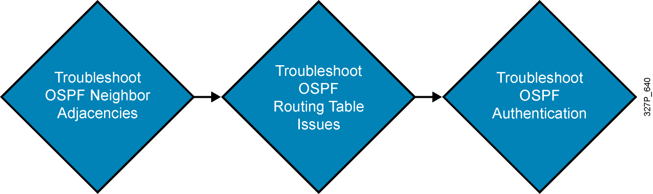
Components of Troubleshooting OSPF

Slide 3
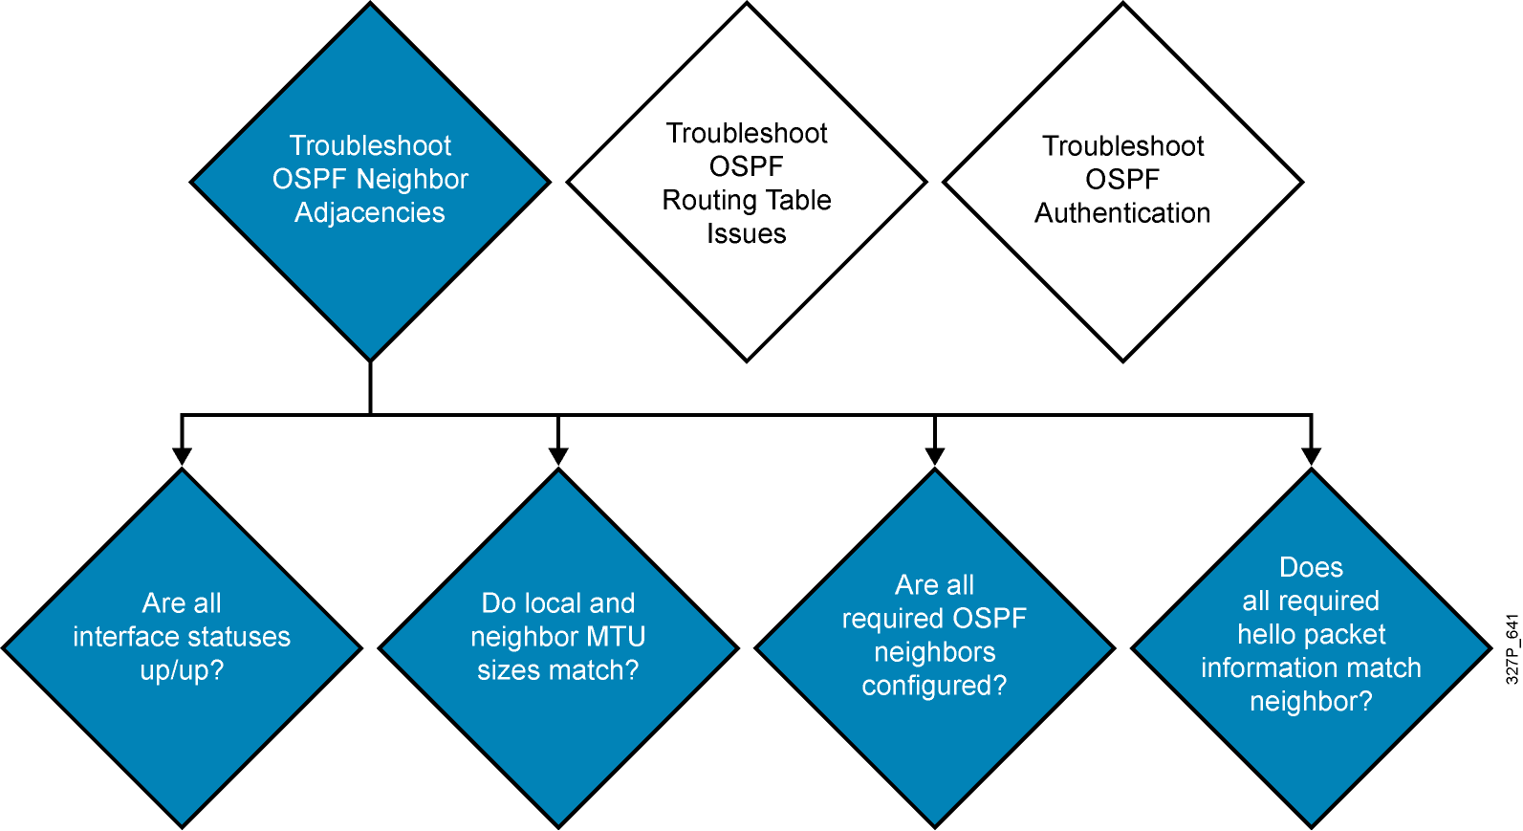
Troubleshooting OSPF Neighbor Adjacencies

Slide 4
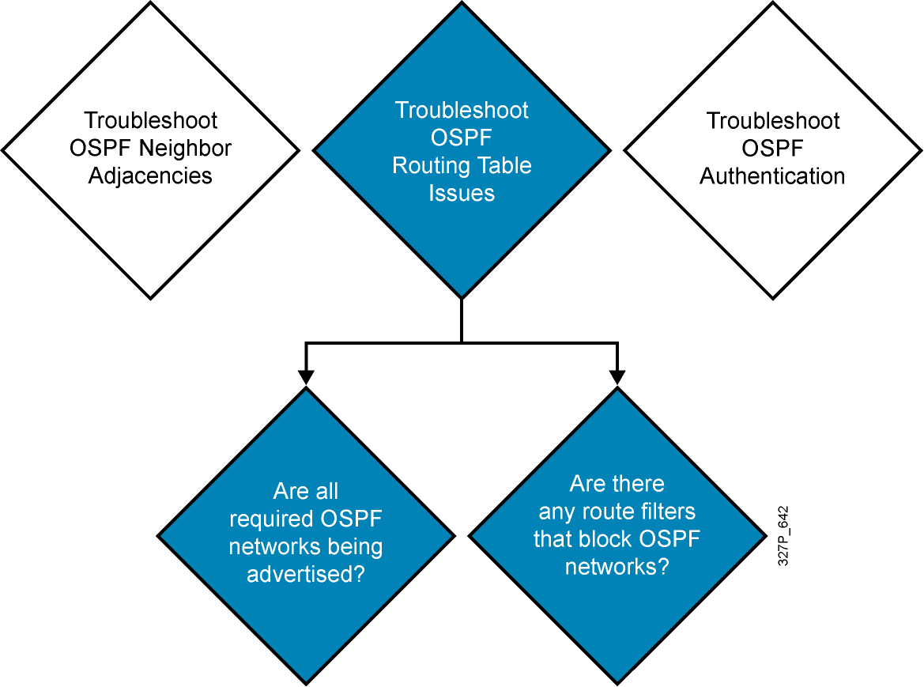
Troubleshooting OSPF Routing Tables

Slide 5
Troubleshooting Plaintext Password Authentication Problems
Plaintext authentication on routerX, no authentication on routerY
RouterX#debug ip ospf adj
*Feb 17 18:51:31.242: OSPF: Rcv pkt from 192.168.1.102, Serial0/0/1 :
Mismatch Authentication type. Input packet specified type 0, we use type 1
RouterY#debug ip ospf adj
*Feb 17 18:50:43.046: OSPF: Rcv pkt from 192.168.1.101, Serial0/0/1 :
Mismatch Authentication type. Input packet specified type 1, we use type 0
Authentication on routerX and routerY, but different passwords
RouterX#debug ip osp adj
*Feb 17 18:54:01.238: OSPF: Rcv pkt from 192.168.1.102, Serial0/0/1 :
Mismatch Authentication Key - Clear Text
RouterY#debug ip ospf adj
*Feb 17 18:53:13.050: OSPF: Rcv pkt from 192.168.1.101, Serial0/0/1 :
Mismatch Authentication Key - Clear Text

Slide 6
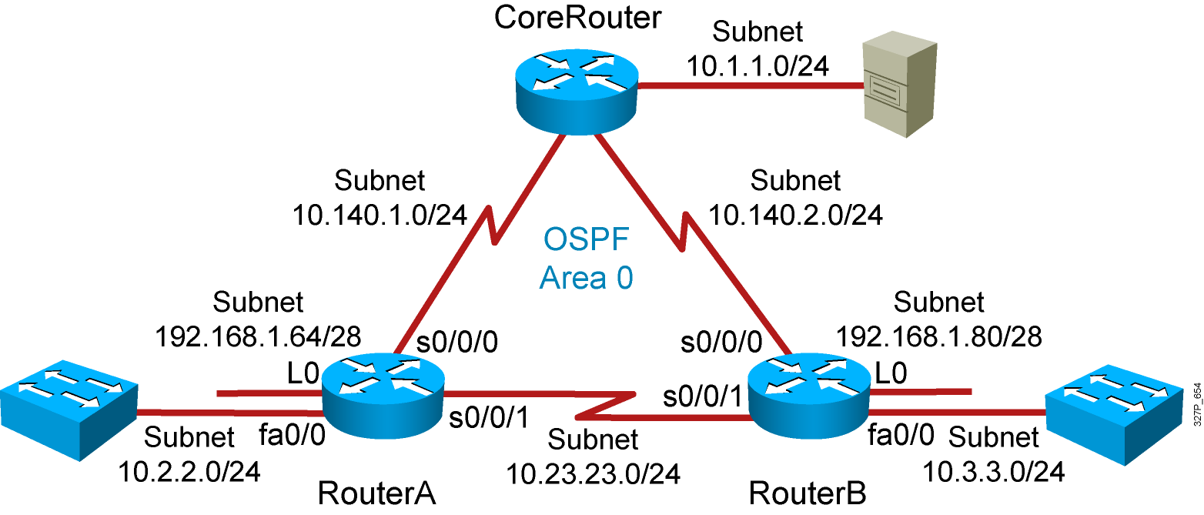
Visual Objective 4-2:
Troubleshooting OSPF
Notes:
Lab 10 amended pod b and pod I addresses move core_ro address closer to interface same with s0 pod L
Objectives: Enable the IGRP dynamic routing protocol so your router can learn about nonconnected networks.
Purpose: Teach students how to enable IGRP.
Laboratory Instructions: Refer to the lab setup guide.

Slide 7
Summary
  Troubleshooting OSPF involves looking at neighbor adjacencies, routing tables, and authentication issues.
  Use the show ip interface command to verify the MTU of an OSPF interface.
  Use the show ip ospf interface command to help troubleshoot whether OSPF is enabled on an interface.
  Use the debug ip ospf adj command to troubleshoot OSPF authentication.

